Slide 1
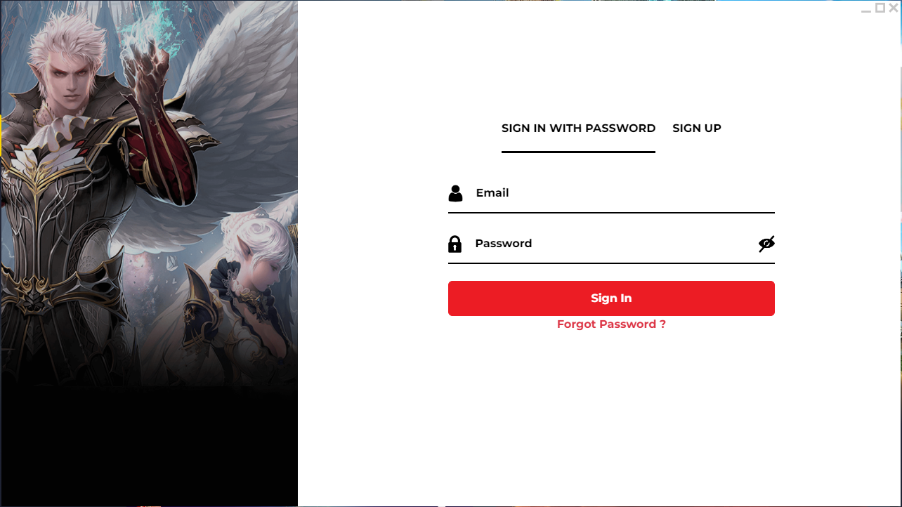
Authentication Page Changes
Background change to same UI as Main Page (ie. Bluestack theme) or a Dark UI or Animated Background
Google Login
Facebook Login

Slide 2
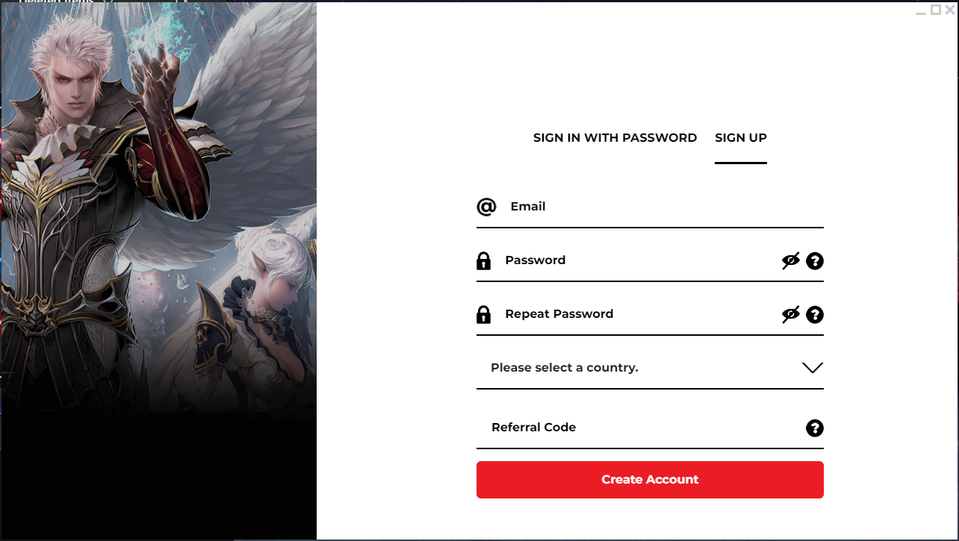
Sign Up Page Changes
Background change to same UI as Main Page (ie. Bluestack theme) or a Dark UI or Animated Background
Hover text “Check your Email for Verification Email”

Slide 3
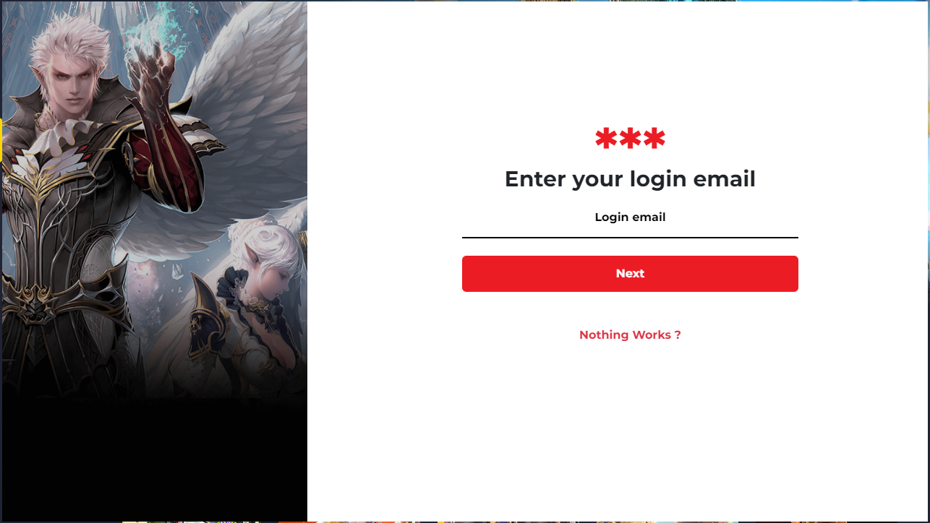
Forgot Password Page Changes
Background change to same UI as Main Page (ie. Bluestack theme) or a Dark UI or Animated Background

Slide 4
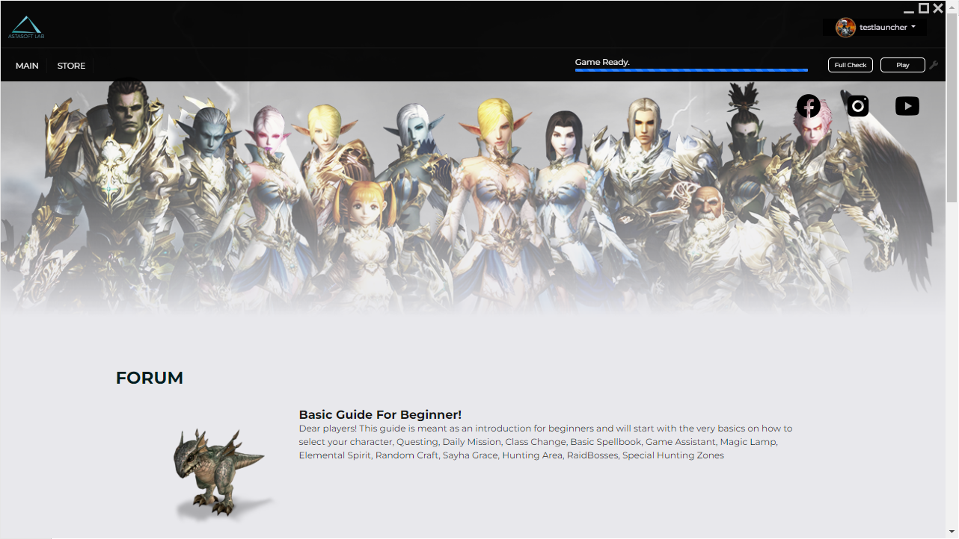
Current Mainpage

Slide 5
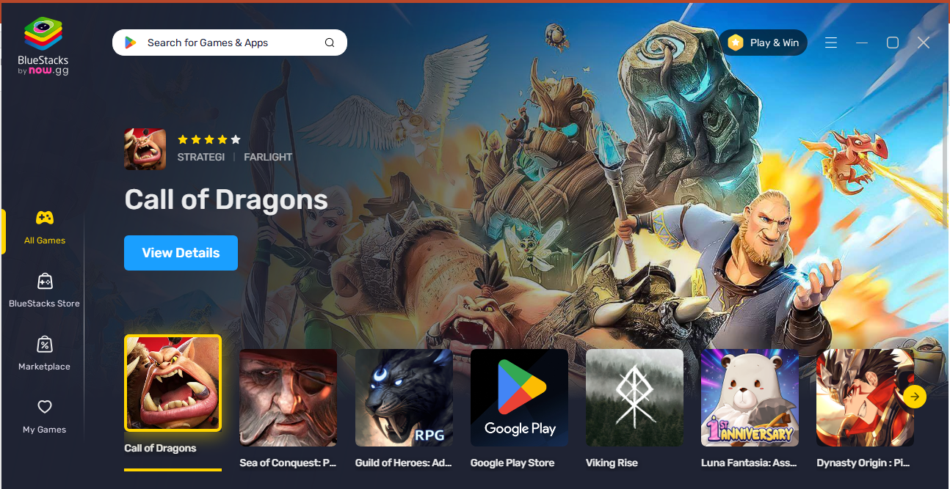
Logo
Mainpage Changes
Account
Background change to same UI as Main Page (ie. Bluestack theme) or a Dark UI
Hovering on Game Icon will change the background
Left Nav Bar Consist
Games
Store
Marketplace <- when click opened a page coming soon
Remove / Not needed
Facebook, Instagram, Youtube Icon

Slide 6
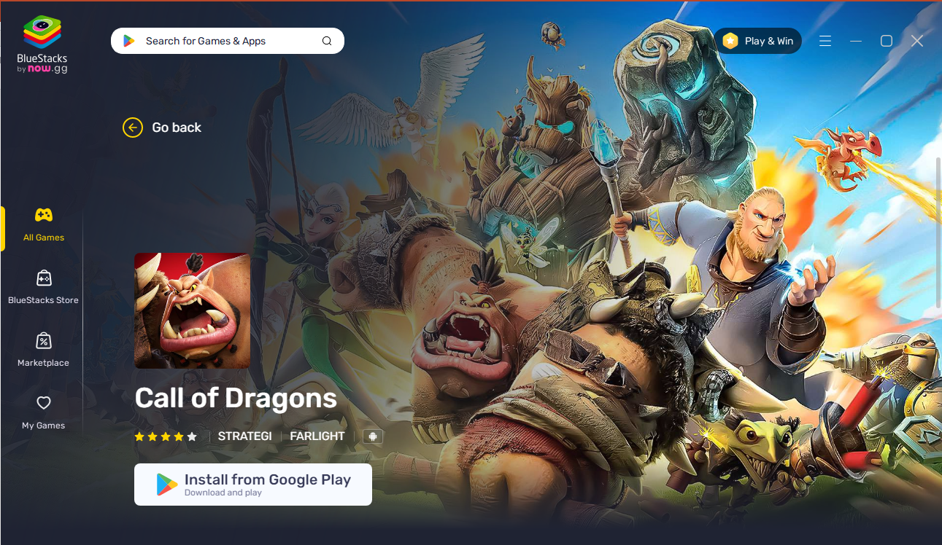
(New) Gamepage
Background change to same UI as Main Page (ie. Bluestack theme) or a Dark UI
Game Icon
Game Image Background
Check Files Button
Download/Update Bar
Play Button

Slide 7
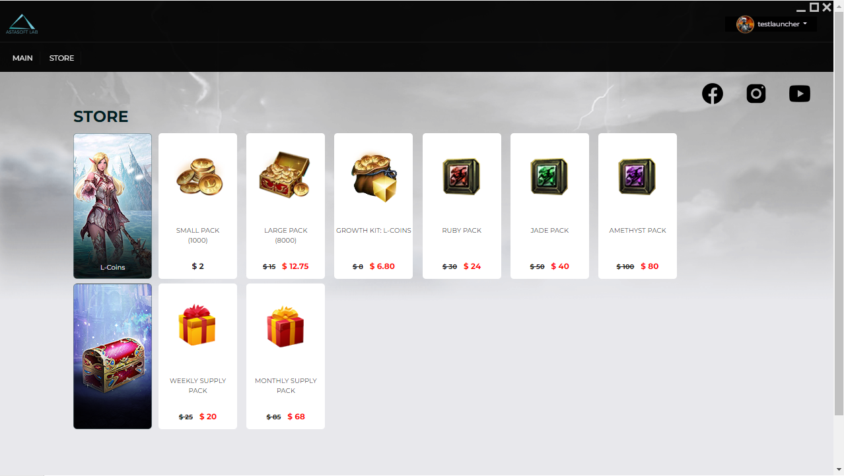
Current Store Page (Client)

Slide 8
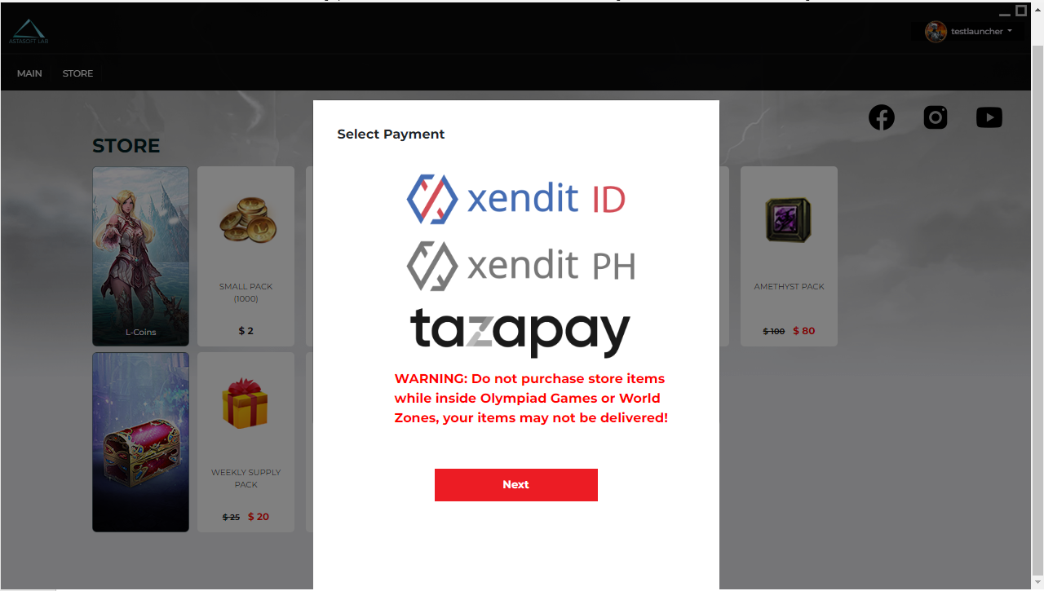
Current Payment Modal

Slide 9
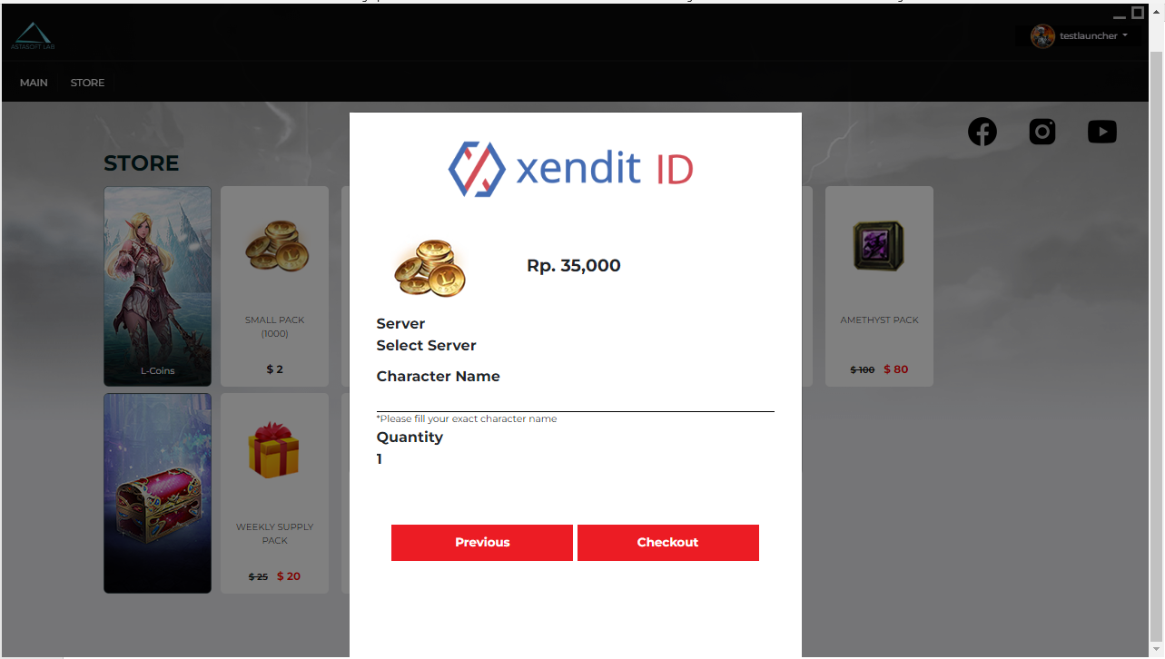
Current Xendit ID Payment Form
Changes required
Form modal background change to fit UI
Drop down opt on Server Selection
Server opt will be 6 servers
On server Opt 1-4 there will be no Character name section
On server Opt 5-6 there will be Character name text fill
Quantity are a text fill

Slide 10
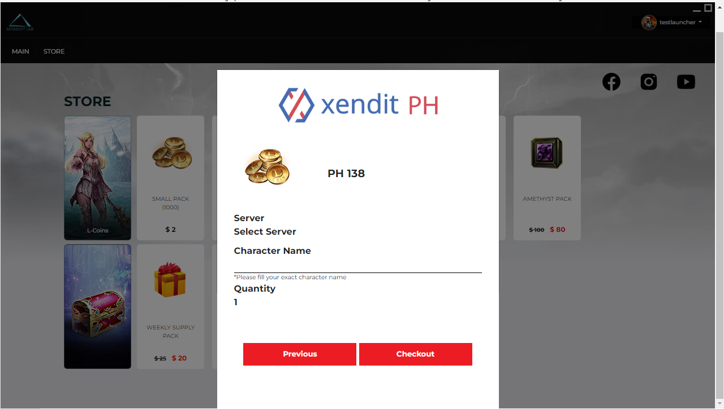
Current Xendit PH Payment Form
Changes required
Form modal background change to fit UI
Drop down opt on Server Selection
Server opt will be 6 servers
On server Opt 1-4 there will be no Character name section
On server Opt 5-6 there will be Character name text fill
Quantity are a text fill

Slide 11
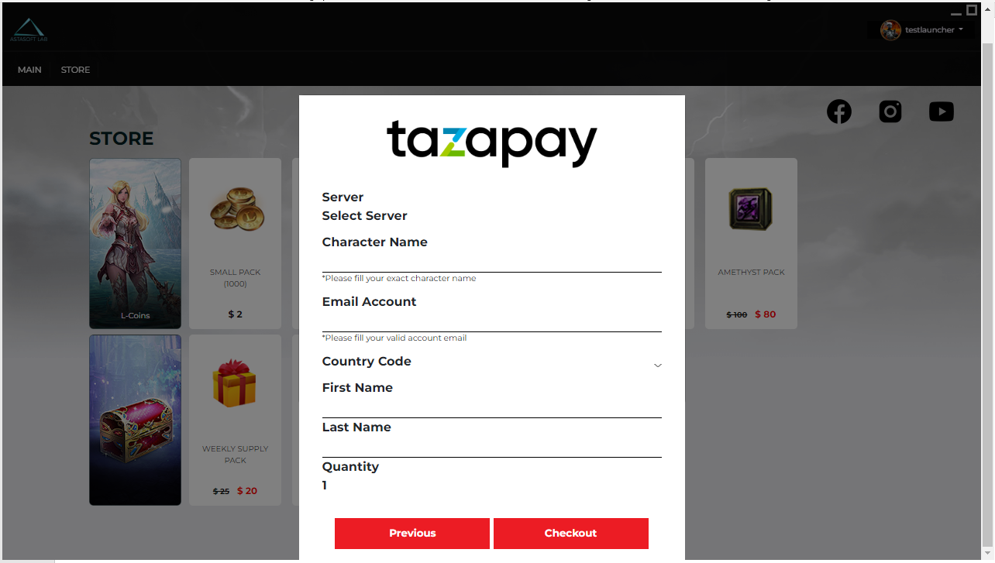
Current Tazapay Payment Form
Changes required
Form modal background change to fit UI
Drop down opt on Server Selection
Server opt will be 6 servers
On server Opt 1-4 there will be no Character name section
On server Opt 5-6 there will be Character name text fill
Email Account text fill
Country Code Drop down opt
First name and Last name text fill
Quantity are a text fill

Slide 12
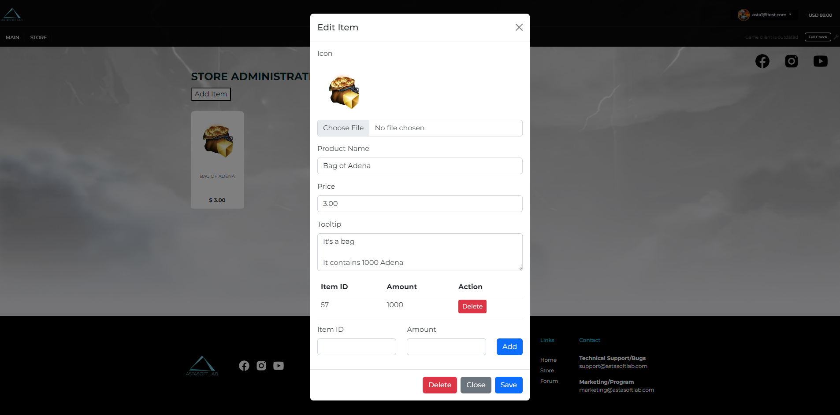
Current Store Page (Admin)

Slide 13
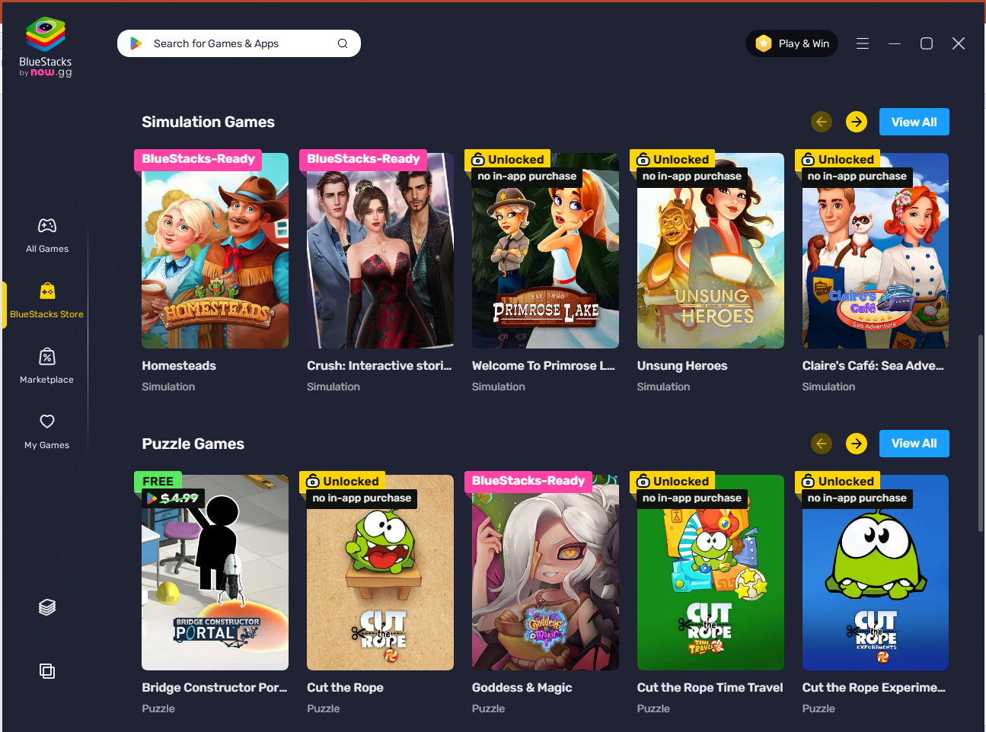
Event Packs
Store Page Changes (Admin)
Background change to same UI as Main Page (ie. Bluestack theme) or a Dark UI
Rework “looks” on Add Item/pack form
Pack position on Admin Store will reflect on Client Store Pack position
Add/Remove Pack button
Remove pack on Admin page will remove pack on Client Store page
Game Name
Permanent Packs

Slide 14
Event Packs
Store Page Changes (Client)
Background change to same UI as Main Page (ie. Bluestack theme) or a Dark UI
Pack position on Admin Store will reflect on Client Store
Rework “looks” on Add Item/pack form
Game Name
Permanent Packs

Slide 15
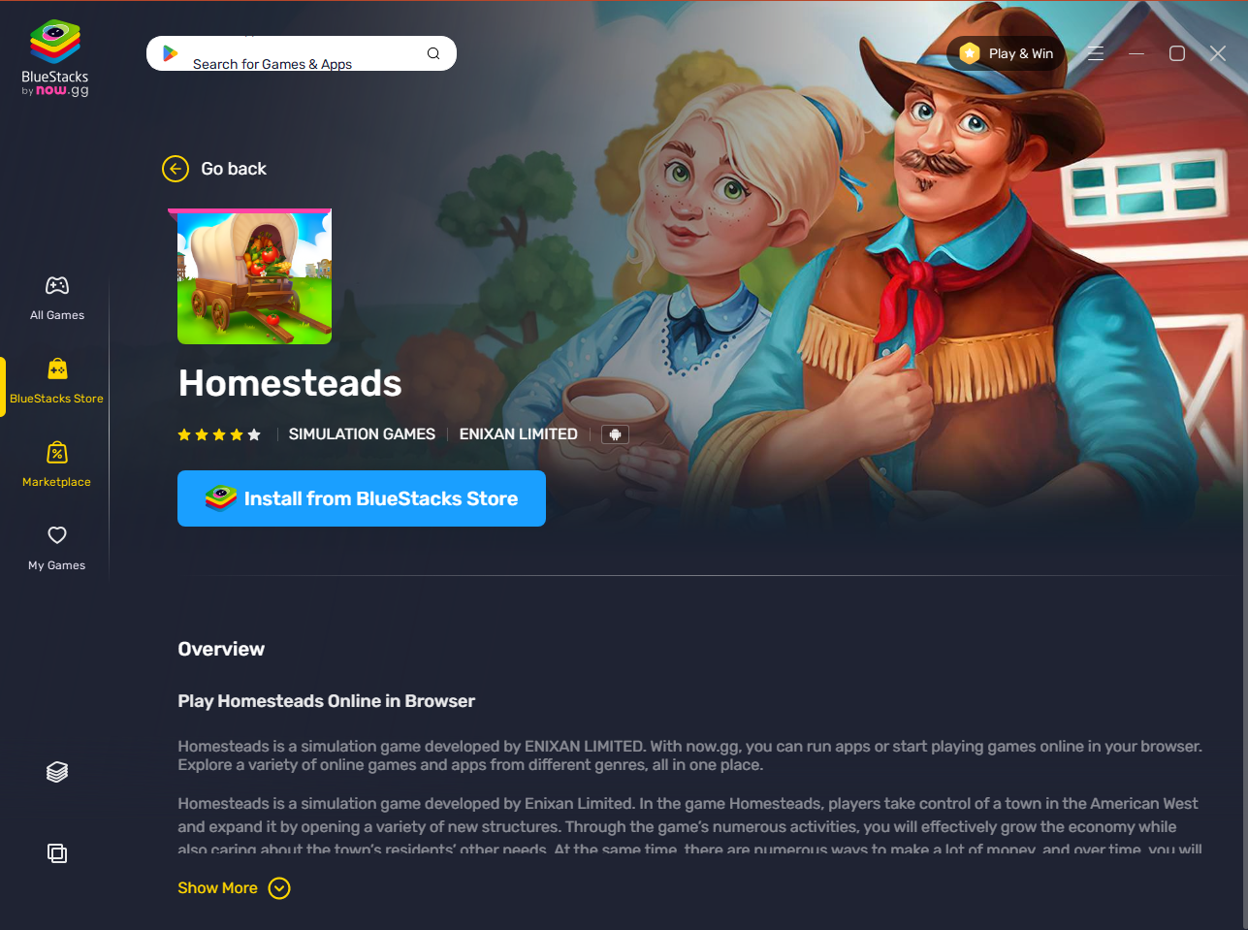
Pack Page Changes (Client)
Background change to same UI as Main Page (ie. Bluestack theme) or a Dark UI
Pack position on Admin Store will reflect on Client Store
Rework “looks” on Add Item/pack form
Pack Price (USD)
Buy Pack/Choose payment gateway (ie. Xendit, Tazapay)
Pack Description and Pack Item Content

Slide 16
Other Changes
Logo Splashscreen before main page are open
Rework “looks” on payment form (modal)
Pack creation page (admin wise) for Store page (client wise)
Tools for easy change on all images, icons, text, color
Resizeable (minimize, maximize, free-size)
Sequence are Logo Splashscreen > mainpage > click account to sign-up/sign-in > sign-up/sign-in page or forgot password page
Transparent slide/scroll bar
Disable right click function

